Slide 1
Builder Pattern
By
Narendran, S S

Slide 2
Key Items
Similar “Construction Process” for various Object representations.
Reuse of “Construction Process”.
Parsing Complex Structures.
Director & Builder
Telescoping constructor - Antipattern

Slide 3
Builder Pattern
The Builder pattern separates the “construction process” of a complex object from its representation so that the same construction process can create different representations.

Slide 4
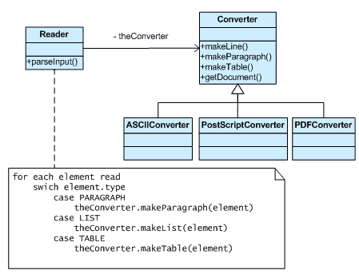
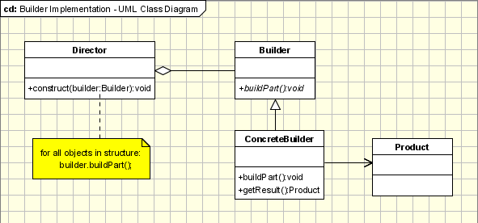
Builder Pattern - UML

Slide 5
Telescoping Constructor Antipattern
The telescoping constructor anti-pattern occurs when the increase of object constructor parameter combination leads to an exponential list of constructors. Instead of using numerous constructors, the builder pattern uses another object, a builder, that receives each initialization parameter step by step and then returns the resulting constructed object at once.

Slide 6
Builder & other Patterns
Sometimes creational patterns are complementary: Builder can use one of the other patterns to implement which components get built. Abstract Factory, Builder, and Prototype can use Singleton in their implementations.
Builder focuses on constructing a complex object step by step. Abstract Factory emphasizes a family of product objects (either simple or complex). Builder returns the product as a final step, but as far as the Abstract Factory is concerned, the product gets returned immediately.
Builder often builds a Composite.
Often, designs start out using Factory Method (less complicated, more customizable, subclasses proliferate) and evolve toward Abstract Factory, Prototype, or Builder (more flexible, more complex) as the designer discovers where more flexibility is needed.

Slide 7
Pros and Cons
Pros
Helpful for step by step building of Complex objects representations with common “Construction process”.
The builder pattern has another benefit. It can be used for objects that contain flat data (html code, SQL query, X.509 certificate...), that is to say data that can't be easily edited. This type of data can not be edited step by step and must be edited at once. The best way to construct such an object is to use a builder class.
Cons
“Construction Process” for various representation of Complex objects should be similar.

Slide 8
References
http://www.oodesign.com/builder-pattern.html
http://sourcemaking.com/design_patterns/builder

